Slide 1
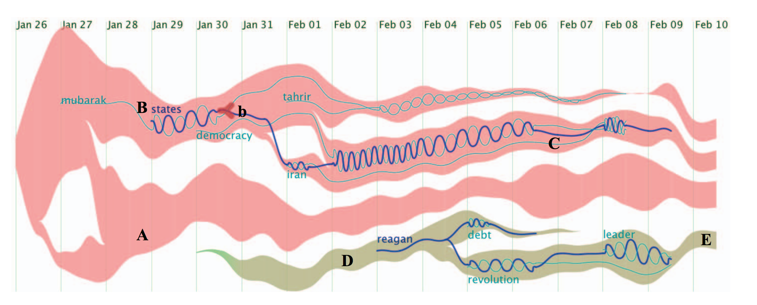

Case study 1: text flow

Slide 2
Case study 1: text flow
introduction
Data type:
individual topics with time stamped
connection between topics
tasks:
the topic evolution trend
the critical event
the keyword correlation
Visual unit:
Stream graph
Glyph
thread
Notes:
Step1:introduction
Use edit data type,
Design task,
visual units,
the relationship between visual units
The relationship between visual units and design tasks

Slide 3
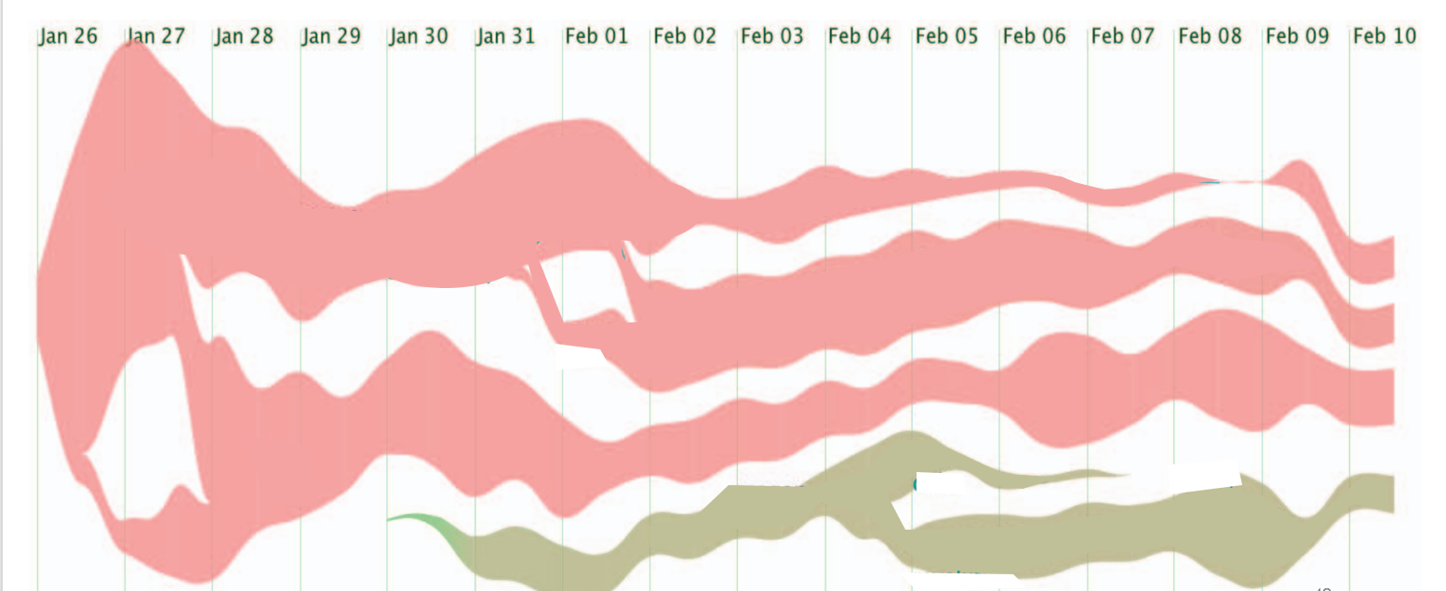
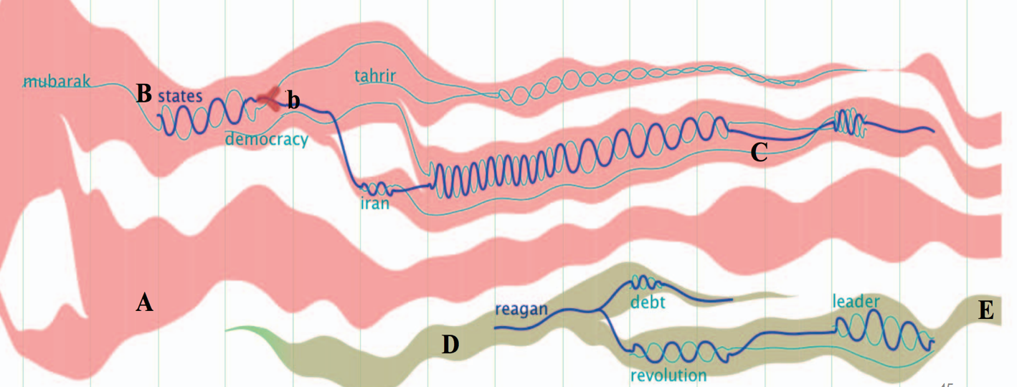
Stream graph
glyph
thread
Notes:
Step 2: visual units decomposition
A tree to show the relationship between visual units:
If A is the child of B, it means A logically depend on B
we should explain A first, then explain B. Like DFS.
At the beginning, there is no visual units showing on the figure;
When we visit a visual unit A (start to explain it), the corresponding tree node will has a border
When we finish the explanation of A, on figure: it will remain but its opacity will decrease,
on tree: the border will disappear
Then we will visit its child node, which has logic dependency on it.

Slide 4
Stream graph
glyph
thread
Notes:
Step 2: visual units decomposition
Flicker: an effective attention attractor.

Slide 5
Stream graph
glyph
thread
Notes:
Step 3: visual units explanation one by one following logic dependency
3.1: stream graph: build-in block available
3.2: glyph
3.3: thread

Slide 6
Stream graph
glyph
thread
Early time Later time
Time line
Notes:
Step 3.1: visual unit1: stream graph (use build-in block)
the color of the block, importing from example directly.
3.1.1: coordinates: x-aixs;
time line(ordered attribute – magnitude channel)
show from left to right, corresponding to the time
y-aixs:
separated hironzital region(categorical attribute – identity channel):
stacked order(),
height of each stack,

Slide 7
Stream graph
glyph
Stream graph:
Strip
Vertical position + color hue (same meaning)
thread
Documents about topic 1
Early time Later time
Time line
Notes:
Step 3.1: visual unit1: stream graph (use build-in block: introduce the one without merging/splitting first)
3.1.1: coordinates: x-aixs;
y-aixs: stacked order, height
3.1.2: mark1--strip: encodes of the mark
channels: color hue
color saturation/opacity:
vertical position
width
start/end point

Slide 8
Stream graph
glyph
Stream graph:
Strip
Vertical position + color hue (same meaning)
thread
Documents about topic 1
Early time Later time
Time line
Notes:
Step 3.1: visual unit1: stream graph (use build-in block: introduce the one without merging/splitting first)
3.1.1: coordinates: x-aixs;
y-aixs: stacked order, height
3.1.2: mark1--strip: encodes of the mark
channels: color hue
color saturation/opacity:
vertical position
width
start/end point

Slide 9
Stream graph
glyph
Stream graph:
Strip
Vertical position + color hue (same meaning)
thread
Documents about topic 2
Documents about topic 1
Early time Later time
Time line
Notes:
Step 3.1: visual unit1: stream graph (use build-in block: introduce the one without merging/splitting first)
3.1.1: coordinates: x-aixs;
y-aixs: stacked order, height
3.1.2: mark1--strip: encodes of the mark
channels: color hue
color saturation/opacity:
vertical position
width
start/end point

Slide 10
Stream graph
glyph
Stream graph:
Strip
Vertical position + color hue (same meaning)
thread
Documents about topic 2
Documents about topic 1
Early time Later time
Time line
Notes:
Step 3.1: visual unit1: stream graph (use build-in block: introduce the one without merging/splitting first)
3.1.1: coordinates: x-aixs;
y-aixs: stacked order, height
3.1.2: mark1--strip: encodes of the mark
channels: vertical position ✓
stacked order
color hue(bonded with vertical position because they have the same encoding meaning)✓
color saturation/opacity:
width
start/end point

Slide 11
Stream graph
glyph
Stream graph:
Strip
Vertical position + color hue (same meaning)
Stacked order
thread
Documents about topic 2
Documents about topic 1
Early time Later time
Time line
Notes:
Step 3.1: visual unit1: stream graph (use build-in block: introduce the one without merging/splitting first)
3.1.1: coordinates: x-aixs;
y-aixs: stacked order, height
3.1.2: mark1--strip: encodes of the mark
channels: vertical position ✓
stacked order ✓ no meaning
color hue(bonded with vertical position because they have the same encoding meaning)✓
color saturation/opacity:
width
start/end point

Slide 12
glyph
Stream graph:
Strip
Vertical position + color hue (same meaning)
Stacked order
Start/end
Stream graph
thread
Start to have documents talking about topic 1 at time point A
Documents about topic 2
Documents about topic 1
Early time Later time
Time line
Notes:
Step 3.1: visual unit1: stream graph (use build-in block: introduce the one without merging/splitting first)
3.1.1: mark1--strip: encodes of the mark: documents about a topic
channels: vertical position ✓
stacked order ✓ no meaning
start/end point:
color hue(bonded with vertical position because they have the same encoding meaning)✓
color saturation/opacity:✓ no meaning
width
start/end point

Slide 13
glyph
Stream graph:
Strip
Vertical position + color hue (same meaning)
Stacked order
Start/end
Stream graph
thread
No documents talking about topic 1 after time point B
Documents about topic 2
Documents about topic 1
Early time Later time
Time line
Notes:
Step 3.1: visual unit1: stream graph (use build-in block: introduce the one without merging/splitting first)
3.1.1: mark1--strip: encodes of the mark: documents about a topic
channels: vertical position ✓
stacked order ✓ no meaning
start/end point:
color hue(bonded with vertical position because they have the same encoding meaning)✓
color saturation/opacity:✓ no meaning
width
start/end point

Slide 14
Stream graph
glyph
Stream graph:
Strip
Vertical position + color hue (same meaning)
Stacked order
Start/end
width
thread
Documents about topic 2
Less documents about topic 1 at this time point
Documents about topic 1
Early time Later time
Time line
Notes:
Step 3.1: visual unit1: stream graph (use build-in block: introduce the one without merging/splitting first)
3.1.1: mark1--strip: encodes of the mark: documents about a topic
channels（order of telling: complexity of encoding, visual salience, ）
vertical position： ✓
stacked order： ✓ no meaning
start/end point: ✓
color hue(bonded with vertical position because they have the same encoding meaning)✓
color saturation/opacity:✓ no meaning
width

Slide 15
Stream graph
glyph
Stream graph:
Strip
Vertical position + color hue (same meaning)
Stacked order
Start/end
width
thread
Documents about topic 2
Documents about topic 1
Less documents about topic 1 at this time point
Early time Later time
Time line
Notes:
Step 3.1: visual unit1: stream graph (use build-in block: introduce the one without merging/splitting first)
3.1.1: mark1--strip: encodes of the mark: documents about a topic
channels（order of telling: complexity of encoding, visual salience, ）
vertical position： ✓
stacked order： ✓ no meaning
start/end point: ✓
color hue(bonded with vertical position because they have the same encoding meaning)✓
color saturation/opacity:✓ no meaning
width

Slide 16
Stream graph
glyph
Stream graph:
Strip
Vertical position + color hue (same meaning)
Stacked order
Start/end
width
thread
Documents about topic 2
Documents about topic 1
Early time Later time
Time line
Notes:
Step 3.1: visual unit1: stream graph (use build-in block: introduce the one without merging/splitting first)
3.1.1: mark1--strip: encodes of the mark: documents about a topic
channels（order of telling: complexity of encoding, visual salience, ）
vertical position： ✓
stacked order： ✓ no meaning
start/end point: ✓
color hue(bonded with vertical position because they have the same encoding meaning)✓
color saturation/opacity:✓ no meaning
width✓

Slide 17
Stream graph
glyph
Stream graph:
Strip
Vertical position + color hue (same meaning)
Stacked order
Start/end
Width
Stream graph → merging/splitting
thread
topic 2b
topic 2a
Topic 1a
topic 2c
Documents about topic 1b
Early time Later time
Time line
Notes:
Step 3.1: visual unit1: stream graph (use build-in block: introduce the one without merging/splitting first)
3.1.1: mark1--strip: encodes of the mark: documents about a topic
channels（order of telling: complexity of encoding, visual salience, ）
vertical position： ✓
stacked order： ✓ no meaning
start/end point: ✓
color hue(bonded with vertical position because they have the same encoding meaning)✓
color saturation/opacity:✓ no meaning
width

Slide 18
Stream graph
glyph
Stream graph:
Strip
Vertical position + color hue (same meaning)
Stacked order
Start/end
Width
Stream graph → merging/splitting
thread
topic 2b
topic 2a
Topic 1a
topic 2c
Documents about topic 1b
merge
Early time Later time
Time line
Notes:
Step 3.1: visual unit1: stream graph (use build-in block: introduce the one without merging/splitting first)
3.1.1: mark1--strip: encodes of the mark: documents about a topic
channels（order of telling: complexity of encoding, visual salience, ）
vertical position： ✓
stacked order： ✓ no meaning
start/end point: ✓
color hue(bonded with vertical position because they have the same encoding meaning)✓
color saturation/opacity:✓ no meaning
width

Slide 19
Stream graph
glyph
Stream graph:
Strip
Vertical position + color hue (same meaning)
Stacked order
Start/end
Width
Stream graph → merging/splitting
thread
topic 2b
topic 2a
splitting
splitting
topic 2c
Topic 1a
Documents about topic 1b
merge
Early time Later time
Time line
Notes:
Step 3.1: visual unit1: stream graph (use build-in block: introduce the one without merging/splitting first)
3.1.1: mark1--strip: encodes of the mark: documents about a topic
channels（order of telling: complexity of encoding, visual salience, ）
vertical position： ✓
stacked order： ✓ no meaning
start/end point: ✓
color hue(bonded with vertical position because they have the same encoding meaning)✓
color saturation/opacity:✓ no meaning
width ✓

Slide 20
Stream graph
Glyph:
Node: encode: an event of a topic flow
position: x-time point, y-topic
color
size
shape
glyph
thread
topic 2b
topic 2a
topic 2c
Topic 1a
Documents about topic 1b
Early time Later time
Time line
Notes:
Step 3.1: visual unit1: stream graph (use build-in block: introduce the one without merging/splitting first)
3.1.1: mark1--strip: encodes of the mark: documents about a topic
channels（order of telling: complexity of encoding, visual salience, ）
vertical position： ✓
stacked order： ✓ no meaning
start/end point: ✓
color hue(bonded with vertical position because they have the same encoding meaning)✓
color saturation/opacity:✓ no meaning
width ✓

Slide 21
Stream graph
Glyph:
Node: encode: an event of a topic flow
position: x-time point, y-topic
color: no meaning
size
shape
glyph
thread
topic 2b
topic 2a
topic 2c
Topic 1a
Documents about topic 1b
Early time Later time
Time line
Notes:
Step 3.1: visual unit1: stream graph (use build-in block: introduce the one without merging/splitting first)
3.1.1: mark1--strip: encodes of the mark: documents about a topic
channels（order of telling: complexity of encoding, visual salience, ）
vertical position： ✓
stacked order： ✓ no meaning
start/end point: ✓
color hue(bonded with vertical position because they have the same encoding meaning)✓
color saturation/opacity:✓ no meaning
width ✓

Slide 22
Stream graph
Glyph:
Node: encode: an event of a topic flow
position: x-time point, y-topic
color: no meaning
size: importance score of this event
shape
glyph
thread
topic 2b
topic 2a
topic 2c
Topic 1a
Documents about topic 1b
Early time Later time
Time line
Notes:
Step 3.1: visual unit1: stream graph (use build-in block: introduce the one without merging/splitting first)
3.1.1: mark1--strip: encodes of the mark: documents about a topic
channels（order of telling: complexity of encoding, visual salience, ）
vertical position： ✓
stacked order： ✓ no meaning
start/end point: ✓
color hue(bonded with vertical position because they have the same encoding meaning)✓
color saturation/opacity:✓ no meaning
width ✓

Slide 23
Stream graph
Glyph:
Node: encode: an event of a topic flow
position: x-time point, y-topic
color: no meaning
size: importance score of this event
shape: source, sink, split, merge
glyph
thread
topic 2b
source
topic 2a
split
topic 2c
Topic 1a
Documents about topic 1b
merge
sink
Early time Later time
Time line
Notes:
Step 3.1: visual unit1: stream graph (use build-in block: introduce the one without merging/splitting first)
3.1.1: mark1--strip: encodes of the mark: documents about a topic
channels（order of telling: complexity of encoding, visual salience, ）
vertical position： ✓
stacked order： ✓ no meaning
start/end point: ✓
color hue(bonded with vertical position because they have the same encoding meaning)✓
color saturation/opacity:✓ no meaning
width ✓

Slide 24
Stream graph
thread
glyph
Documents about topic 2
Documents about topic 1
Early time Later time
Time line
Notes:
Step 3.1: visual unit1: stream graph (use build-in block: introduce the one without merging/splitting first)
3.1.1: coordinates: x-aixs;
y-aixs: stacked order, height
3.1.2: mark1--strip: encodes of the mark
channels: color hue
color saturation/opacity:
vertical position
width
start/end point

Slide 25
Stream graph
thread
glyph
Topic 3
Topic 2
Topic 1
Early time Later time
Time line
Notes:
Step 3.1: visual unit1: stream graph (use build-in block: introduce the one without merging/splitting first)
3.1.1: coordinates: x-aixs;
y-aixs: stacked order, height
3.1.2: mark1--strip: encodes of the mark
channels: color hue
color saturation/opacity:
vertical position
width
start/end point

Slide 26
Stream graph
thread
glyph
Topic 3
Topic 2
Topic 1
Early time Later time
Time line
Notes:
Step 3.1: visual unit1: stream graph (use build-in block: introduce the one without merging/splitting first)
3.1.1: coordinates: x-aixs;
y-aixs: stacked order, height
3.1.2: mark1--strip: encodes of the mark
channels: color hue
color saturation/opacity:
vertical position
width
start/end point
3.1: visual unit1:stream graph: morphing to the one with merging/spliting
what is added? The transition line from a strip to another
line as a mark: Color, width, shape, intensity, position
what is changed? none

Slide 27
Stream graph
thread
glyph
Topic 3
Topic 2
Topic 1
Early time Later time
Time line
Notes:
Step 3.1: visual unit1: stream graph (use build-in block: introduce the one without merging/splitting first)
3.1.1: coordinates: x-aixs;
y-aixs: stacked order, height
3.1.2: mark1--strip: encodes of the mark
channels: color hue
color saturation/opacity:
vertical position
width
start/end point
3.1: visual unit1:stream graph: morphing to the one with merging/spliting
what is added? The transition line from a strip to another
line as a mark: Color, width, shape, intensity, position
what is changed? none

Slide 28
Case study: text flow
Overview:
Visual unit:
Coordinate:

Slide 29
Case study: text flow
Visual unit 1

Slide 30
Case study: text flow
Visual unit 2

Slide 31
Case study: text flow
Visual unit 3

